Slide 1
Brief Introduction
to
Technical Communication

Slide 2
Topics to be dealt with
Introduction to Technical Communication (Week 14)
Emails for work (Week 14)
Memos (Week 15)
Résumés for job application (Week 16)
Instructions and user manuals (Week 17)

Slide 3
Definition of Technical Communication
1
General communication vs. Technical communication
2
目 录
CONTENTS
3
Objectives of TC
4
Characteristics of TC
5
Brief introduction to ethics

Slide 4

Definition of Technical Communication
What is meant by “communication”?
the exchange of information, ideas, and knowledge between a sender and a receiver
Communication in oral or written form
What is meant by “Technical Communication”?
the process of making and sharing information and ideas in the workplace
a set of applications — the documents that are written.

Slide 5
GC vs. TC
What are the difference between general communication and technical communication?
General communication
Contains a general message
Informal in style and approach
No set pattern of communication
Mostly oral
Not always for a specific audience
involve no technical vocabulary or graphics, etc.
Technical communication
Contains a technical message
Mostly formal
Follows a set pattern
Both oral and written
Always for a specific audience
Frequently involves jargon, graphics, etc.

Slide 6
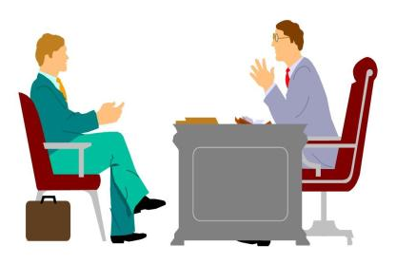
Objectives of TC
What are the objectives of technical communication?
To provide organized information that aids in quick decision-making
To invite corporate joint ventures
To disseminate knowledge in oral or written form

Slide 7

Characteristics of TC
What are the characteristics of technical communication?
correct
accurate
clear
appropriate
to the point
The language should be clear and easy to understand.
The information must be brief and arranged sequentially.
The technical information provided in the manual should be accurate.

Slide 8
Levels of communication
At what levels does communication take place?
Extrapersonal communication
communication between human beings and non-human entities
Intrapersonal communication
communication within an individual
Interpersonal communication
communication among people
Organizational communication
communication in an organization at different hierarchical levels
internal-operational, external-operational, and personal communication
Mass communication
communication through mass media such as journals, books, television, newspapers

Slide 9
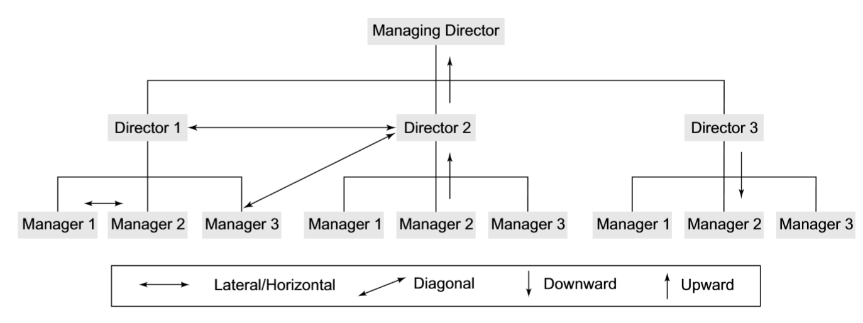
Flow of communication in an organization
How does communication flow in an organization?
horizontal/lateral communication
vertical communication
diagonal communication

Slide 10
Think and decide
Vertical communication
Communication between superiors and subordinates
Teacher
Horizontal/Lateral communication
Communication between peers
monitor 1
monitor 2
monitor 3
TM leader 1
TM leader 2
TM leader 3
TM leader 1
TM leader 2
TM leader 3
M1
M2
M3
M1
M2
M3
Diagonal communication
Communication between superiors and subordinates without going through the hierarchical set-up inside the organization

Slide 11
A brief introduction to ethics
There are many serious ethical and legal issues related to technical communication, and all professionals need a basic understanding of them.
Rights: individuals’ basic needs and welfare.
Justice: how the costs and benefits of an action or a policy are distributed among a group.
Utility: the positive and negative effects that an action or a policy has, will have, or might have on others.
Care: the relationships we have with other individuals.
Ethicist Manuel G. Velasquez outlines four moral standards that are useful in thinking about ethical dilemmas (2006):

Slide 12
Drafting Emails for Work

Slide 13
1
Learning by doing
2
Elements in an email
目 录
CONTENTS
3
Email etiquette
4
Questions for review

Slide 14

What should we do first when we write an email in the workplace?
find out the company’s e-mail policies
circumstances under which we may and may not use e-mail
principles we should use in writing e-mails
the monitoring of employee e-mail

Slide 15
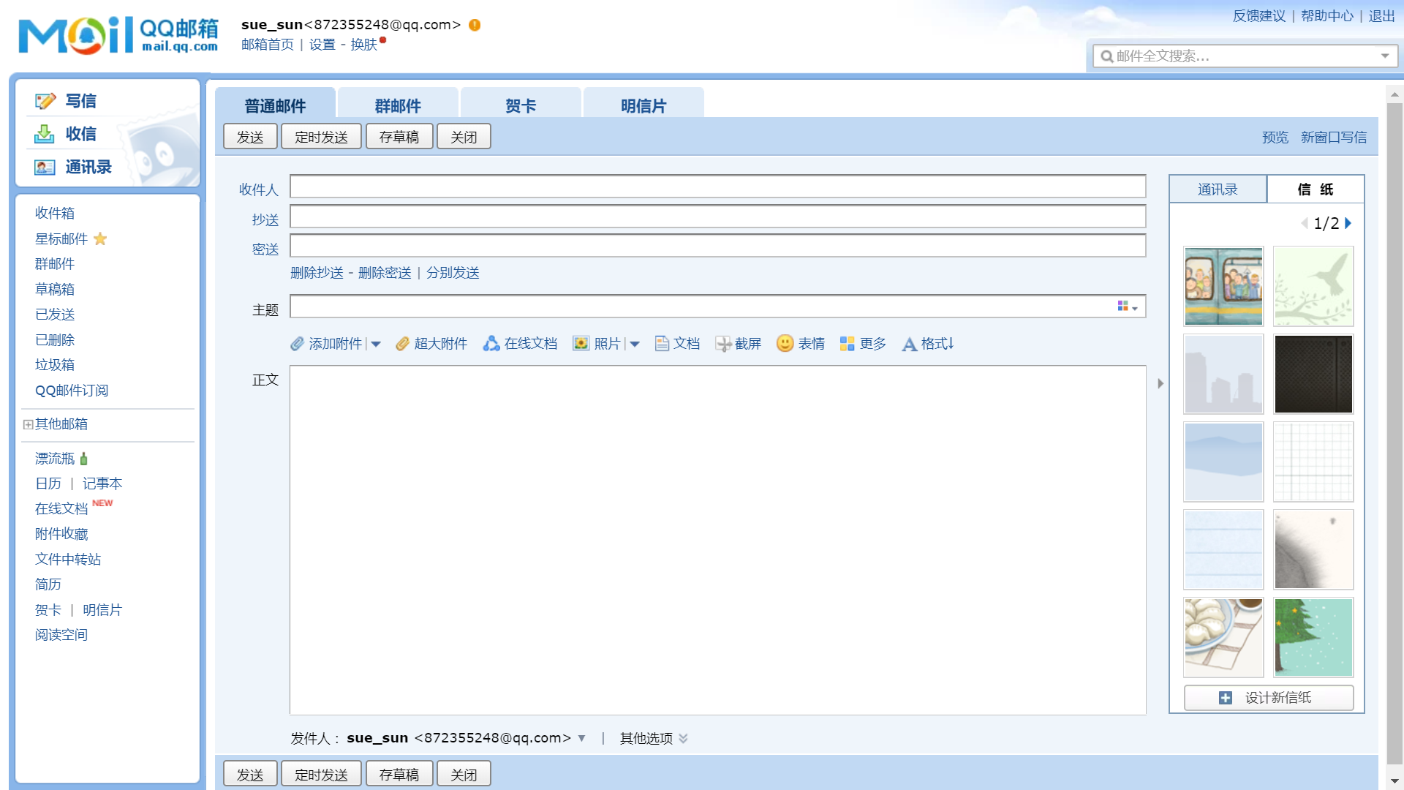

Slide 16
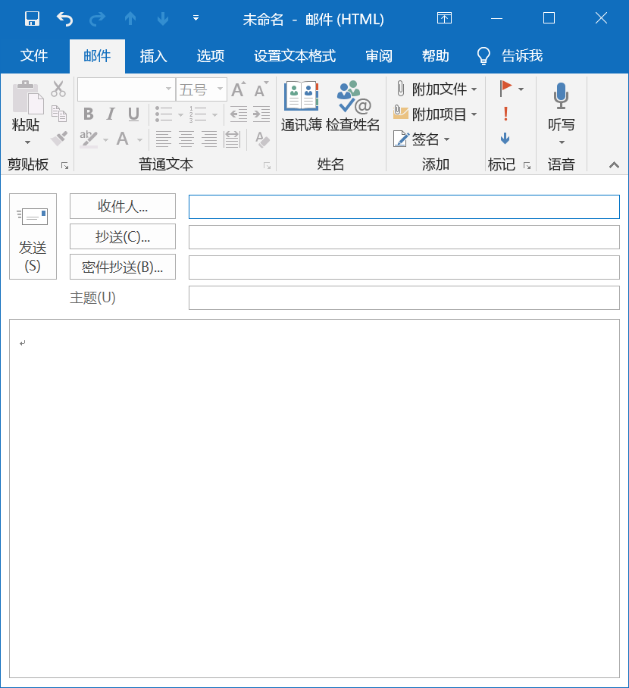
To
CC=courtesy copy
BC or BCC=blind courtesy copy
Subject
1. Suppose the team leader writes an email to all the members who have to read the mail, in which box should the writer put the members’ address?
2. Suppose the team leader writes an email to the monitor, he/she wants his/her members to know this, but he doesn’t want the monitor and his/her members to know that he/she also sends the email to the teacher, in which box should the writer put the monitor, his/her members and the teacher respectively?
To: All Members
To: Monitor
CC: All Members
BCC: Teacher

Slide 17
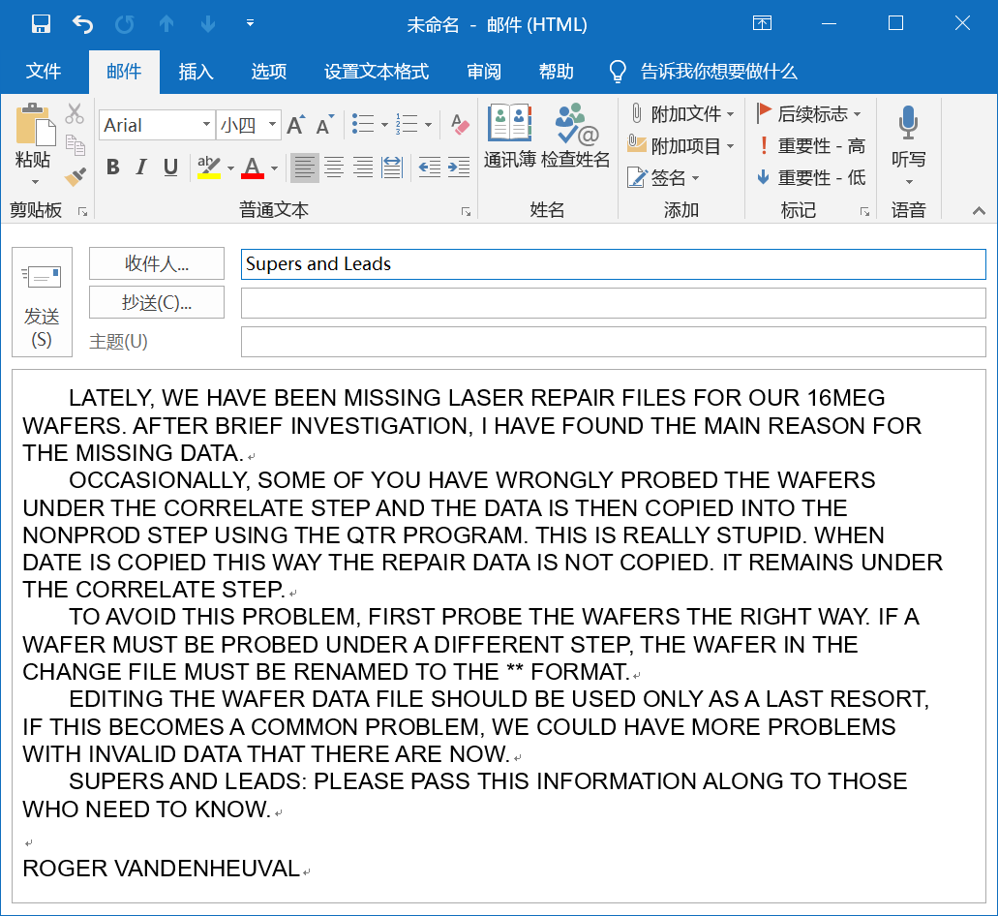
Comment on the following email
The messages are written in capital /uppercase letters.
It is difficult to read.
It appears as if the writer is yelling at his/her reader(s).

Slide 18
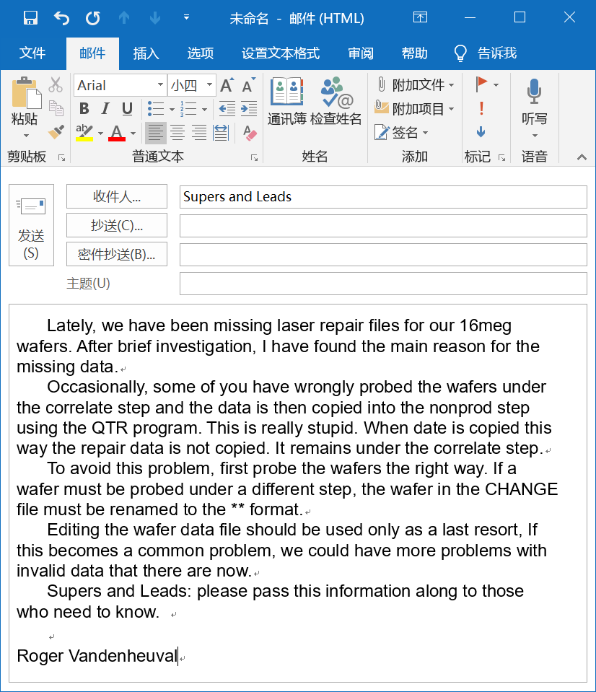
The writer does not state his purpose in the subject line and the first paragraph.
Salutation is not written.
The writer’s tone is hostile.
The writer has not proofread it.
The writer does not conclude politely.

Slide 19
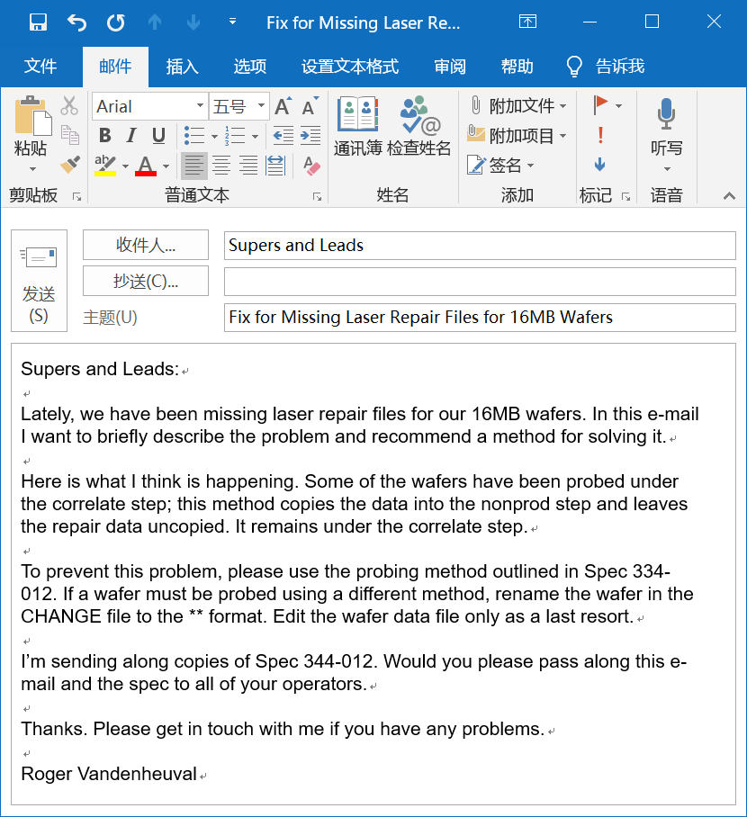
The subject line and first paragraph clearly state the writer’s purpose.
Double-spacing between paragraphs makes the e-mail easier to read.
The writer concludes politely.

Slide 20
Style, Structure, and Content
From: To: Cc: Bcc: Sent: Subject: Attachment:
Email messages must be kept brief; ideally, under 200 words.
The tone, i.e. the audience and purpose of the email, should be carefully considered.
Poor spelling and grammar in email messages could lead some readers to question the writer’s competence.
Always take the time to consider the effect that the tone, style, grammar, and spelling of a mail may have on the recipient.
Header
salutation
Body
message
close
Name
Office title
Address
Phone number
signature
signature block

Slide 21
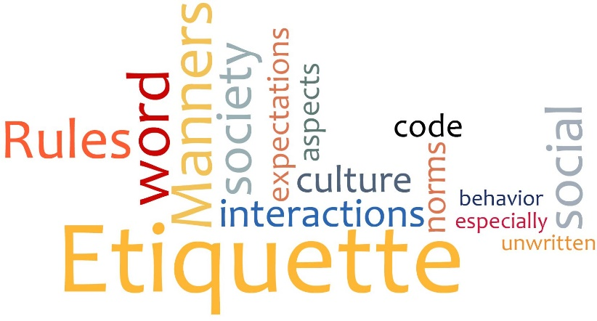

Email etiquette
Write correctly
Use appropriate formality
Use proper structure and layout
Identify yourself and the topic
Be careful with formatting
Be concise and to the point
Use proper spelling, grammar, and punctuation
Re-read the email before sending it
Do not write in CAPITALS
Avoid long sentences
Use active instead of passive voice
Keep the language gender-neutral
Maintain coherence

Slide 22
Answer swiftly
Answer all questions, and pre-empt further questions
Use templates for frequently used responses
Take care with abbreviations and emoticons
Be kind. Do not flame.
Do not overuse Reply All
Do not overuse the high priority option
Do not attach unnecessary files
Do not use email to discuss confidential matters
Avoid using URGENT and IMPORTANT
Do not reply to spam
Don’t forward a message to an online discussion forum without the writer’s permission
Don’t send a message unless you have something to say

Slide 23

Level of formality
the frozen style
the formal style
the consultative style
the casual style
the intimate style
庄严体
正式体
商议体
随意体
亲密体

Slide 24
Read and Decide
1) My dear father has just expired.
2) My old man just kicked the bucket.
3) My dad has died.
4) My beloved parent has just passed to his heavenly reward.
5) My father has just passed away.
--- by Martin Joos
Frozen Formal Consultative Casual Intimate
( ) ( ) ( ) ( ) ( )
4
1
5
3
2

Slide 25
Read and Decide
Our meeting with United went south right away when they threw a hissy fit, saying that we blew off the deadline for the progress report.
In our meeting, the United representative expressed concern that we had missed the deadline for the progress report.
It was indubitably the case that our team was successful in presenting a proposal that was characterized by quality of the highest order. My appreciation for your industriousness is herewith extended.
I think we put together an excellent proposal. Thank you very much for your hard work.
too informal
too formal
Notes:
go south <美口>下跌；减弱；下降；退步 to have a hissy fit 发脾气 blow off: to refuse to take notice of, honor, or deal with : ignore; to end a relationship with

Slide 26
you attitude vs we/me attitude
多用你方态度(you-attitude)，少用我方态度(we/me-attitude)
Correspondence must convey a courteous, positive tone. The key to accomplishing this task is using the “you attitude” — that is, looking at the situation from the reader’s point of view and adjusting the content, structure, and tone to meet his or her needs.
Put yourself in your reader’s shoes
Try to imagine what your reader will feel about what you write
Reflect and emphasize your reader’s needs, interests and concerns
Protect your reader’s ego

Slide 27
Read and Decide
You must have dropped the engine. The housing is badly cracked.
The badly cracked housing suggests that your engine must have fallen onto a hard surface from some height.
accusing
You’ll need two months to deliver these parts? Who do you think you are, the post office?
Surely you would find a two-month delay for the delivery of parts unacceptable in your business. That’s how I feel, too.
sarcastic

Slide 28
Questions for review
Did you refrain from discussing nonbusiness subjects?
Did you keep the e-mail as brief as possible and send it only to appropriate people?
Did you use appropriate formality?
Did you write correctly?
Did you avoid flaming?
Did you write a specific, accurate subject line?
Did you use uppercase and lowercase letters?
Did you skip lines between paragraphs?
Did you keep the line length under 65 characters?
Did you check with the writer before forwarding his or her message?

Slide 29
Thank You for Attention！

